Slide 1

Fleet Data Analysis: ANT Trucks
Group 6
Isaac Mburu
Rishikesh Patil
Tarun Kandarpa
Meghana Nandyalam
Jayakumar Karunanidhi
Mihir Santosh Nevpurkar

Slide 2
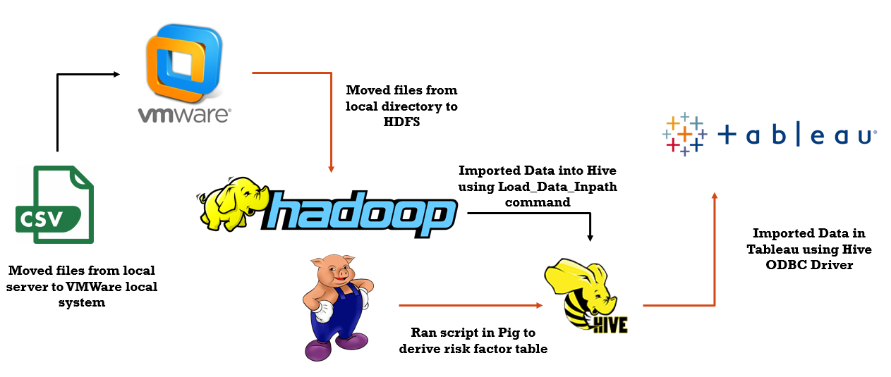
Data Process Flow

Slide 3
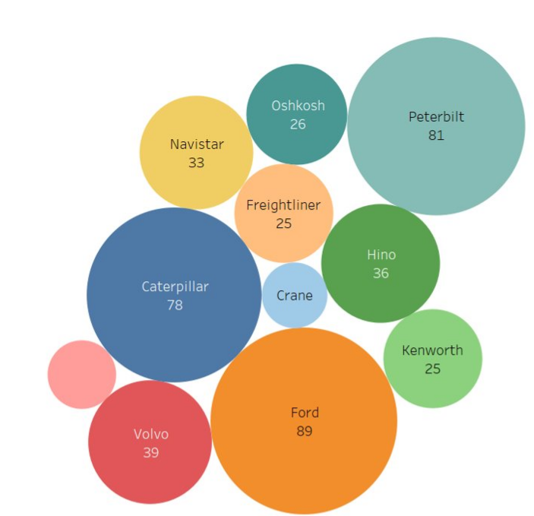

Events by Model
Ford (89), Peterbilt (81) and Caterpillar (78) held the lion’s share of all the events registered
Western Star, Crane and Freightliner recorded the fewest events
Additional data points like Age of the truck model would help improve the reliability of the model

Slide 4
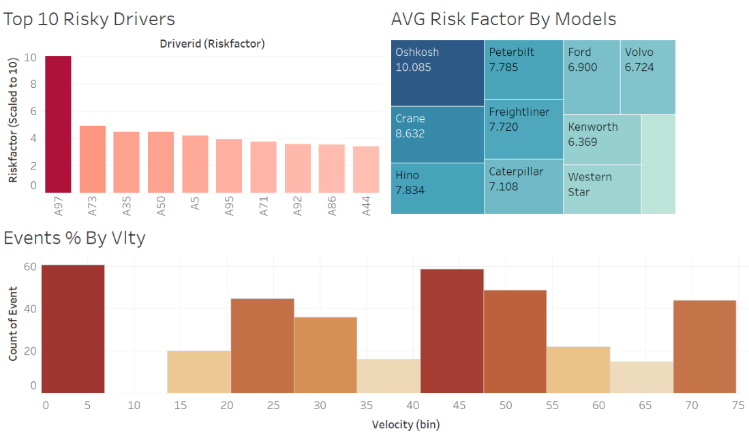
Risk & Models Dashboard

Slide 5
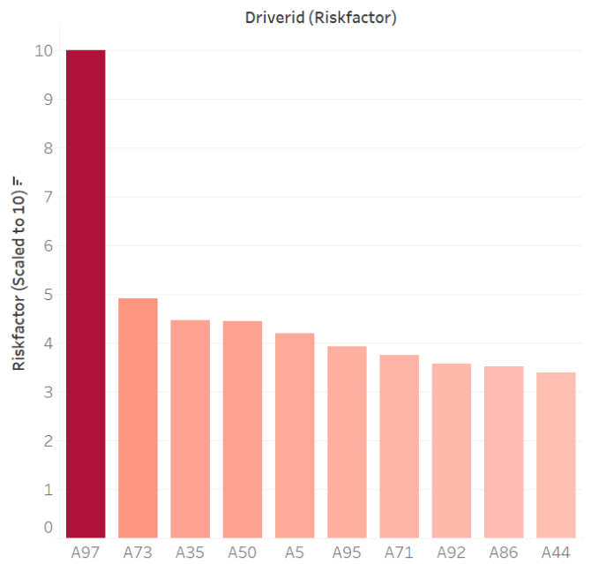



Top 10 Risky Drivers
Driver A97 was identified as the riskiest driver, scoring a 10 on the scale. The driver is therefore unsafe and immediate steps should be initiated to remedy this.
All the remaining drivers had a risk factor score below 5, and hence their driving is considered to be lower on the risk scale
Performance of drivers A73, A50 and A35 should still be monitored, to ensure they continue maintaining lower risk factor while driving

Slide 6
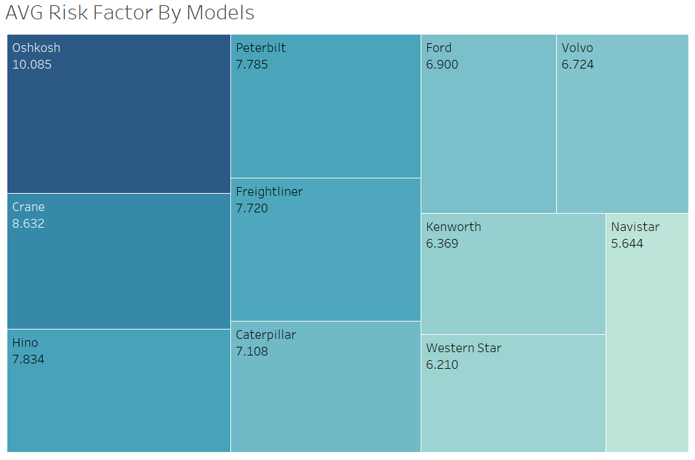

Average Risk Factor by Models
Oshkosh, Crane and Hino were found to be the riskiest models. ANT would be better served collaborating with other vendors for their trucking needs.
Alternately, Navistar, Western Star and Kenworth are great low-risk options, with which the partnerships can be enhanced
Do factors like size of the truck influence the model risk factor? We’d like to have such inputs to predict more accurately

Slide 7
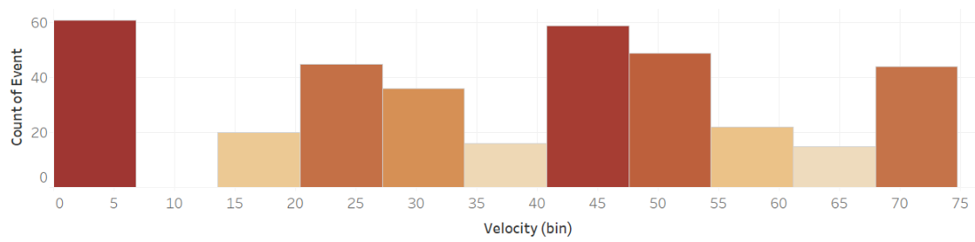

Events by Velocity
Alarming number of events for velocity <5
Jump in the # of events when velocity is between 40-55
Events at velocity >70: A case of over-speeding directly correlating with the events

Slide 8
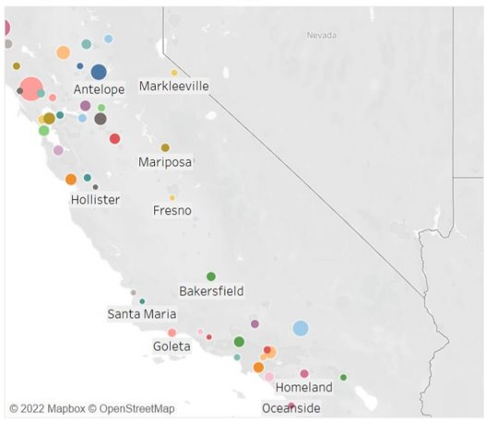

Non-normal Events by city
Non-normal events clustered more towards the North and South of California. Very few events recorded in the central part
Cannot conclusively derive the reason why some cities had more events than the others. It could be influenced due to geography or topography, poor city infra, lack strict traffic rules.

Slide 9
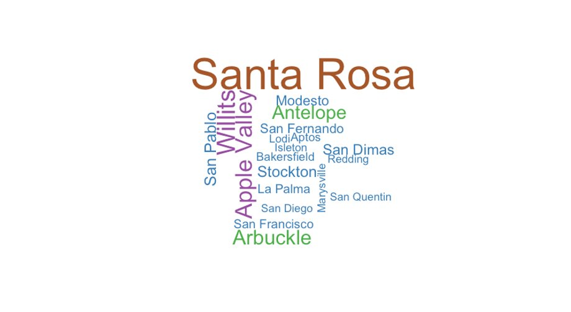

City by Events
Top-5 Cities
Santa Rosa
Willits
Apple Valley
Arbuckle
Antelope

Slide 10
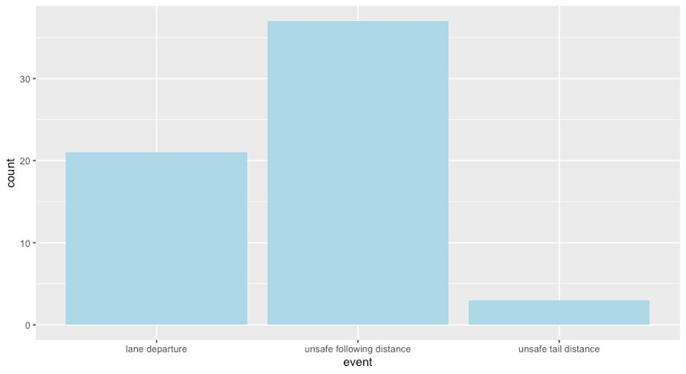

Accidents at 0 velocity
Even at 0 velocity, accidents are being observed. This could suggest impact at the time of application of sudden breaks and needs further investigation.
Unsafe following distance has attracted the maximum number of events at 0 velocity. This aspect could be made the focal-point of driver training modules

Slide 11
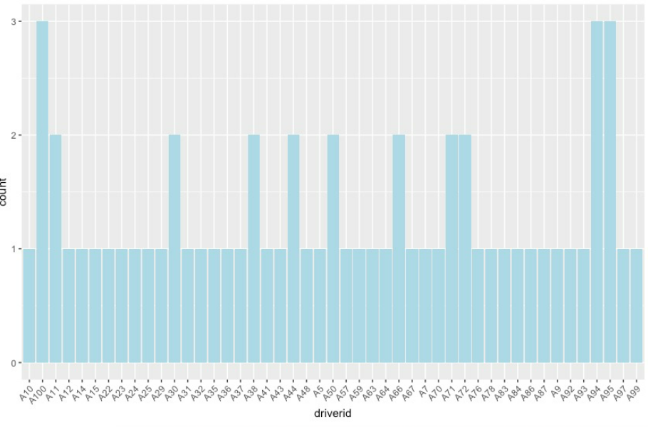
Repeat Mistakes!!
A100, A94, A95 are repeating the same mistake thrice.
What’s causing this? Human or other factors?

Slide 12


